Slide 1
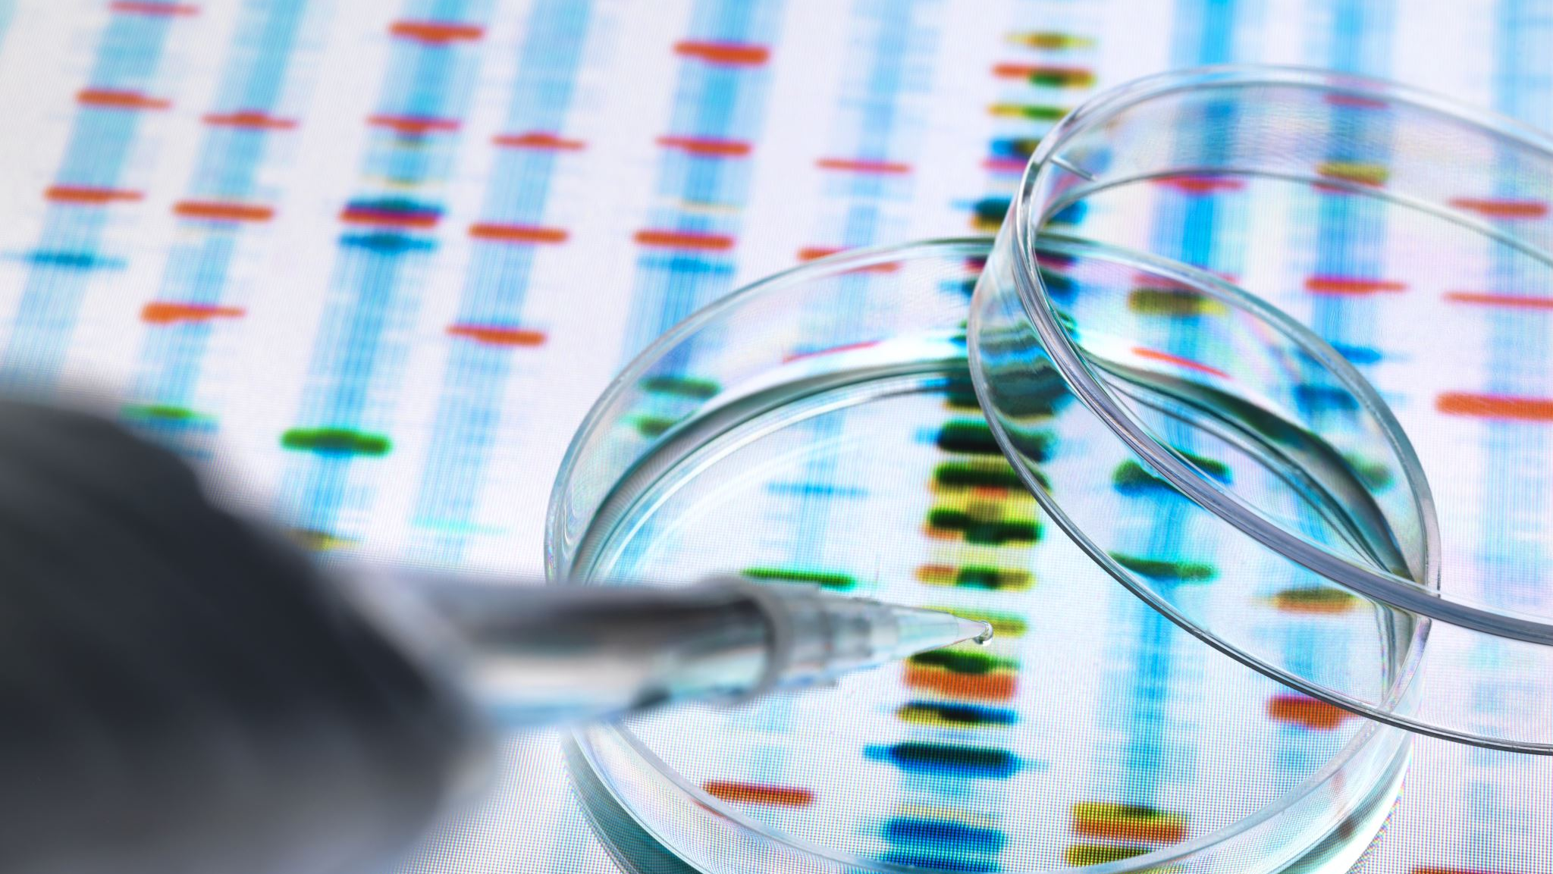
Survey on Algorithms for Personalized Patient Health Informatics and Diagnosis
Michael Rizig

Slide 2
Abstract
The goal of this research is to provide an analysis on the current algorithms used for detection and diagnosis of disease or illness. This research includes discussing the 4 primary approaches to the development of these type algorithms: Supervised Learning, Unsupervised Learning, Statistical Modeling, and custom-made algorithms that utilize some combination of both. We will discuss their strengths and weaknesses, and how they fit into the larger scheme of overall patient diagnosis. This research also covers the primary data sources for collecting anonymous patient data for developing and training machine learning classification algorithms, the use and considerations of this data, and results of each approach.

Slide 3
Data Collection
Collecting high quality data to train models on is the first step to any approach. There are several sources that one can use to collect data ethically. Here are 3 common sources:
MEDICAL IMAGING ARCHIVES (PACS): These archives contain anonymous medical images such as x-rays, scans, MRIS, and other digital medical images. This source would be useful for training a model in machine vision to detect anomalies or cancers in a radiology environment.
EXAMPLES:
https://www.cancerimagingarchive.net/
https://grand-challenge.org/
https://www.cancerimagingarchive.net/browse-collections/
ELECTRONIC HEALTH RECORDS (EHRs): Electronic health records databases incluse both structured and unstructured data and can vary by source. Some form of normalization is probably required.
EXAMPLES:
https://starr.stanford.edu/data-types/electronic-health-record
https://www.nature.com/articles/s41597-022-01899-x
LAB RESULTS DATABSES: This type of data consists of lab results from blood tests, stool tests, urine tests, etc. From my experience these are the hardest to get reliable data from as labs are often private organizations.
EXAMPLE:
https://pmc.ncbi.nlm.nih.gov/articles/PMC2929542/
SKLEARN: The algorithms in this paper will utilize SKLearn’s openly available datasets for training models. This is simply the easiest and most compatible data for the small scale examples in this paper.
EXAMPLE:
https://scikit-learn.org/stable/datasets.html#datasets

Slide 4
Feature Reduction
Feature reduction:
This algorithm utilizes a divide and conquer approach to reduce the number of features while maintain accuracy. This allows for the model to run more efferently as it no longer has to process a high dimensionality of data. Here is the approach:
The time complexity of the feature reduction can be considered m (log reg model epochs) * n (size of data) * log(n) (reduction) or O(m*n*log(n))

Slide 5
Approach
1. SUPERVISED LEARNING:
Supervised learning algorithms utilize datasets with the correct output each data point labeled. By utilizing labeled data, the model can be trained Via backpropagation and can be used on new unseen patient data. Some applications of this type of model include image analysis, radiology, analyzing lab results, and suggesting treatments to certain ailments. Some examples of supervised learning include logistical regression state vector machines and neural networks. By setting the output classes of a neural network to all the possible diseases being tested for, a sufficiently deep neural network utilizing logistical regression may be able to predict diagnosis once trained.
2. UNSUPERVISED LEARNING:
Unsupervised learning is similar to supervised learning with the difference being that data points are not labeled. In this way the model must group data and generate classes based on similarity this type of model can be used to detect anomalies and also classify results with predefined groups. An example of this type of algorithm is a K-Means algorithm. With sufficient generated groups, the model could predict the output of a given datapoint by finding its closest group. It could also detect new groups based on previously unseen trends period
3. STATISTICAL MODELING:
Statistical modeling is a more classical approach to medical diagnosis. These types of models take into account the patients age, symptoms, and medical history to make predictions of what the diagnosis may be via probability. By asking the patient a series of questions, and having storing the conditional probability of each, the model can predict with some accuracy the general diagnosis of a patients illness.
4. CUSTOM ALGORITHMS:
In most cases, when trying to create a system that can reliably predict the diagnosis, a combination of the previous 3 approaches is used. By integrating the three approaches, we can reliably predict the diagnosis of a patient to aid in medical treatment. The tradeoff of this approach is it is the most computationally / time demanding as it would require the use of 3 or more models. These algorithms will not be covered in this paper as they encompass a wide range of solutions.

Slide 6
Supervised Learning
This section contains an example of a basic supervised learning algorithm that could be used to predict if a sample is malignant. The dataset used contains 569 samples classed as either Malignant or Benign, with 212 samples the former and 357 the latter. This algorithm trains a neural network classifier on the data logs the accuracy of the algorithm.
Complexity:
Determining the complexity of a supervised learning algorithm is not very straight forward depending on the type of algorithm. For this implementation, we can consider training and testing as 2 separate events and thus their complexities are distinct.
Training: Training the algorithm consists of passing the dataset through the network and back-progating to update weights. (2n). We do this on all features (k) and repeat this as many times as we need to reach our target epochs (m). Thus, the time complexity of training this supervised algorithm is O(m(n*k)) where n = len(dataset), k = len(features), and m = len(epochs).
Prediction: Predicting if a sample is malignant or not does not require any use of the dataset n. The algorithm utilizes the learned weights to pass the data once through the network and arrive at a result.
Thus the time complexity of prediction is linear, at O(1).

Slide 7
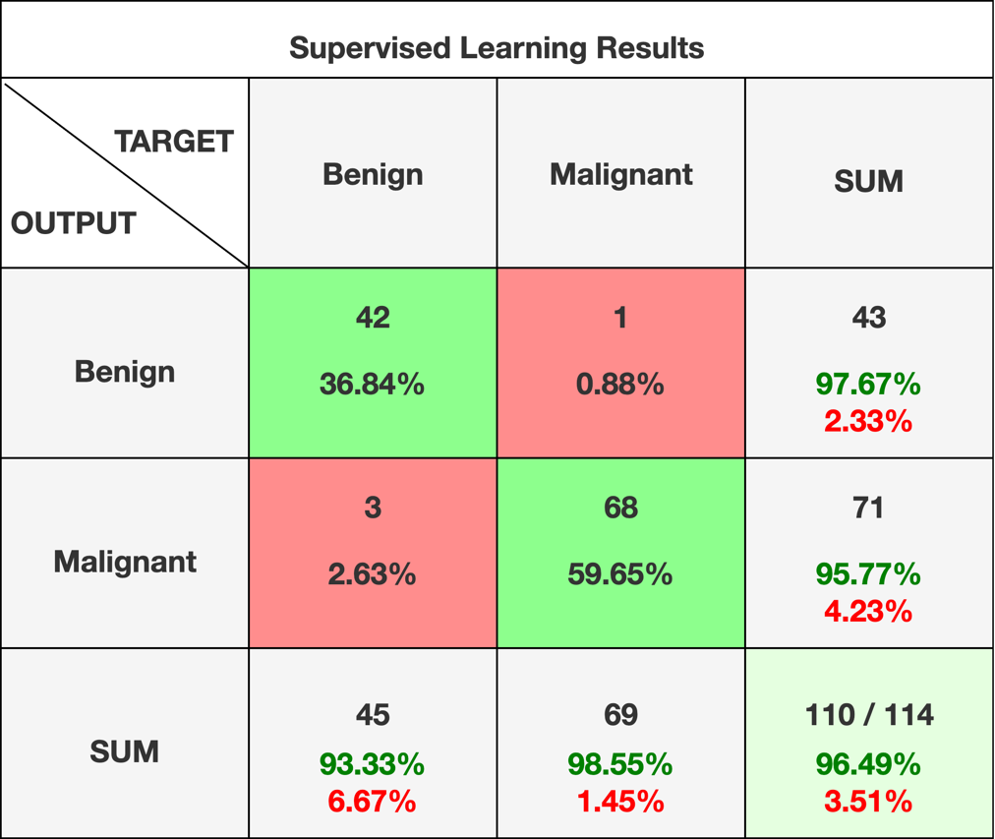
Results - Supervised
Metric | Benign | Malignant | Accuracy | Macro Average | Weighted Average
Precision | 0.98 | 0.99 | 0.98 | 0.98 | 0.98
Recall | 0.98 | 0.99
F1-Score | 0.98 | 0.99
Count | 43 | 71
Figure 1. Supervised Learning Results
Figure 2. Confusion matrices generated via https://www.damianoperri.it/public/confusionMatrix/

Slide 8
Unsupervised Learning
This section contains an example of a basic unsupervised learning algorithm that could be used to predict if a sample is malignant. This algorithm utilizes the same exact dataset as before, but the algorithm does not utilize the labels for training. This algorithm (K-MEANS) creates cluster centers, assigns data based on how close the datapoint is to a given cluster, then re-averages the cluster centers and re-assigns the data again. This way the clusters become more and more fitting of the data it represents. The clusters are then matched with their actual values.
Complexity:
As with Supervised, Unsupervised learning is also broken down into training and testing complexities.
Training: For training, we are passing each datapoint (n) into our graph checking each cluster (2) based on the number of features (m), and we are doing this as many times as we need until our clusters stop changing (for sklearn this runs 10 times, but for demonstration purposeless we will call this k). Thus our training complexity is n * 2 * m * k, or simply O(n*m*k)
Prediction: Predicting our datapoint in this unsupervised algorithm is not linear as it was in our supervised algorithm. It checks each cluster (2) by the number of features in the sample (n), this for our prediction approach our complexity is 2n or O(n), but in cases where the number of clusters is not simple, we can cay O(n*m)

Slide 9
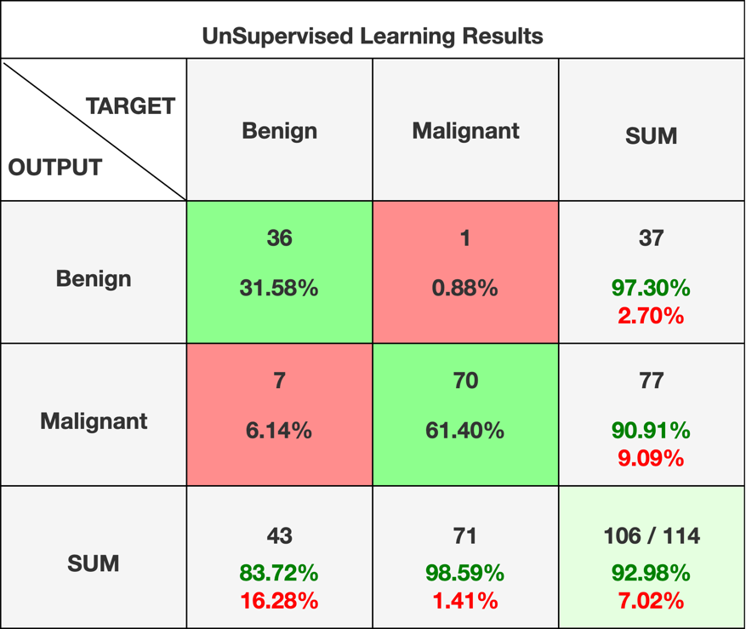
Results - Unsupervised
Metric | Benign | Malignant | Accuracy | Macro Av | Weighted Avg
Precision | 0.97 | 0.909 | 0.9298 | 0.9230 | 0.9283
Recall | 0.837 | 0.985
F1-Score | 0.90 | 0.945
Count | 43 | 71
Figure 3. Unsupervised Learning Results
Figure 4. Confusion matrices generated via https://www.damianoperri.it/public/confusionMatrix/

Slide 10
Statistical Modeling
Statistical Modeling is another method of utilizing models to predict a diagnosis. An excellent example can be found in the paper, Evolving a Bayesian classifier for ECG-based age classification in medical applications by M. Wiggins , A. Saad, B. Litt , G. Vachtsevanos (Reference 22).
In this paper, the researchers utilized a Bayes Classifier for age based classification. Bayes Classifiers work by utilizing prior probabilities to calculate the probability that a data sample belongs in any given class. It does this by multiplying the probability that the data point is in the group (by using the groups frequency over N) then multiplies this by the likelihood of each feature of the example appearing in that group. When done for every group, we get a set of probabilities, and we choose the highest value as our prediction.
Complexity:
As before, we will split the complexity into training complexity and predicting complexity.
Training: For training, we utilize the number of datapoints (n) and for each we utilize each feature (m) and compute the statistics based on these. This we can claim that for our binary approach, the complexity to train the model would be O(n*m). This is significantly faster training than our other two models.
Prediction: Predicting our datapoint in this unsupervised algorithm is not linear as it was in our supervised algorithm. It checks each cluster (2) by the number of features in the sample (n), this for our prediction approach our complexity is 2n or O(n), but in cases where the number of clusters is not simple, we can cay O(n*m)

Slide 11
Results – Statistical Modeling
We can clearly see that of the three models, Statistical performed the worst. This can be attributed to the fact that this type of model does not ‘learn’ trends like a supervised model but rather utilizes the probabilities of those trends.
Custom algorithms can be utilized to cross reference the results of each model. For example, a custom algorithm could run several models and use a voting system to ensure the highest likelihood of having an accurate result. In this approach, we could utilize the previously trained Supervised and Unsupervised algorithms and put all three predictions as votes. If there is a disagreement (2 positives and 1 negative, 2 negatives and 1 positive, etc), the higher frequency result would be the overall output.
Method | Accuracy
AUC | 0.8475
GA | 0.8175
K2 | 0.65
AVERAGE | 0.771
Figure 5. Statistical Modeling Results

Slide 12
Conclusion
When surveying the algorithms for patient diagnosis, we can conclude that Supervised Learning, Unsupervised Learning, and Statistical Modeling algorithms can accurately and consistently detect and diagnose diseases in patients. The implications of these algorithms can be seen in online AI based wellness applications, as well as in the medical field. This technology has already begun testing in radiology and cancer detection applications in the modern medical field. While some algorithms are more accurate than others, there is an increased benefit when using multiple algorithms in collaboration to increase overall accuracy. This technology will likely change the medical landscape and allow for faster, cheaper, and more accurate diagnosis, ultimately making healthcare more accessible and affordable.

